Slide 1

Principles of Machine Learning DSA 5105 • Lecture 8
Soufiane Hayou
Department of Mathematics

Slide 2
So far
Until now, we have focused on supervised learning
Datasets comes in input-label pairs
Goal is to learn their relationship for prediction (the oracle function)
For next few lectures, we are going to look at a variety of unsupervised learning methodologies.
As always, we start with the simplest linear cases and proceed from there.

Slide 3
Unsupervised Learning Overview

Slide 4
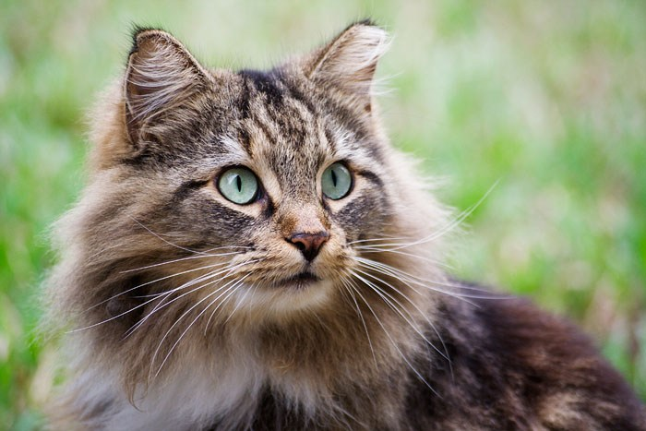
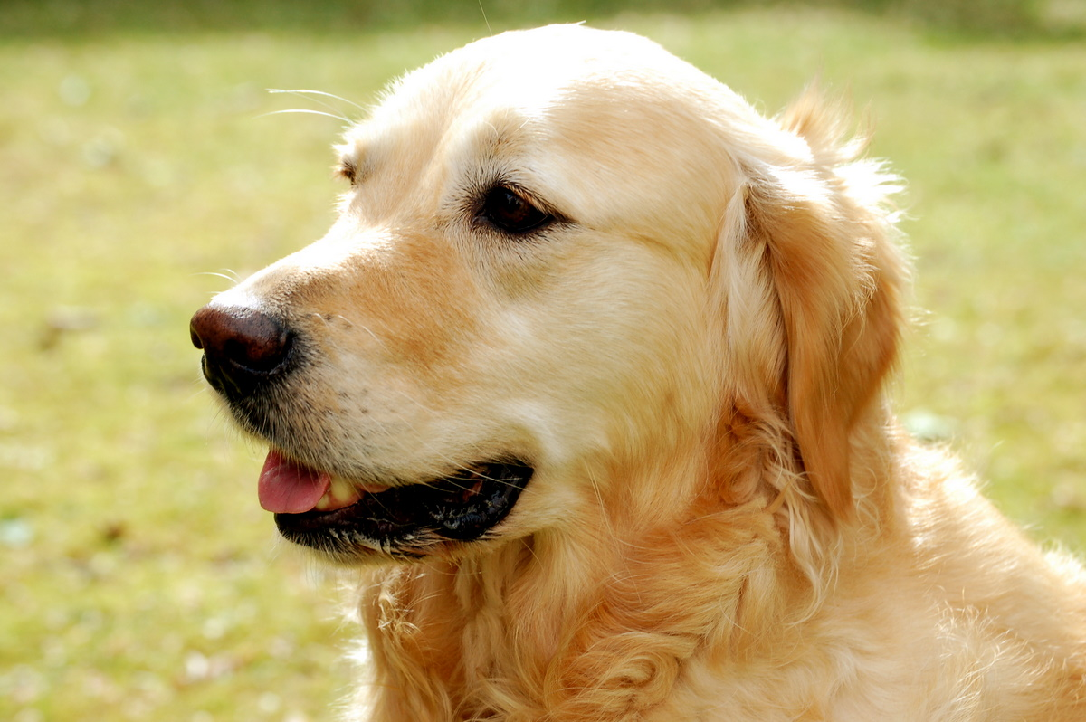
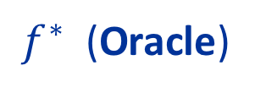
Supervised Learning
Supervised learning is about learning to make predictions
$f^{∗}$ (Oracle)
Cat
Predictive Model
Dog
Our goal: Using data, learn a predictive model that approximates $f^{∗}$

Slide 5
Unsupervised Learning
Unsupervised learning is where we do not have label information
$f^{∗}$ (Oracle)
Cat
Dog
Example goal: learn some task-agnostic patterns from the input data

Slide 6
Examples of Unsupervised Learning Tasks: Dimensionality Reduction
https://media.geeksforgeeks.org/wp-content/uploads/Dimensionality_Reduction_1.jpg

Slide 7
Examples of Unsupervised Learning Tasks: Clustering
https://upload.wikimedia.org/wikipedia/commons/thumb/c/c8/Cluster-2.svg/1200px-Cluster-2.svg.png

Slide 8
Examples of Unsupervised Learning Tasks: Density Estimation
By طاها - Own work, CC BY-SA 3.0, https://commons.wikimedia.org/w/index.php?curid=24309466

Slide 9
Examples of Unsupervised Learning Tasks: Generative Models
http://www.lherranz.org/wp-content/uploads/2018/07/blog_generativesampling.png

Slide 10
Why unsupervised learning?
Labelled data is expensive to collect
Labelled data is impossible to get
Different application scenarios

Slide 11
Principal Component Analysis

Slide 12
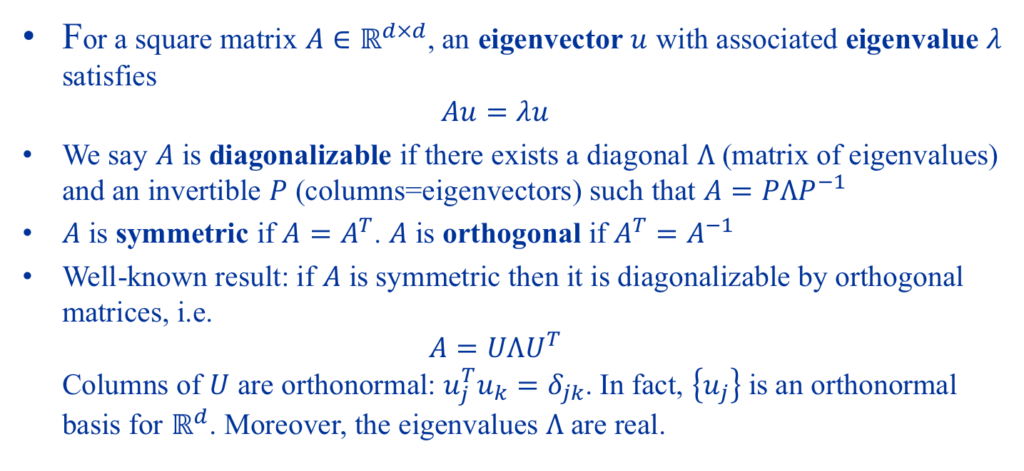
Review: Eigenvalues and Eigenvectors
For a square matrix $A∈ℝ^{d×d}$, an eigenvector $u$ with associated eigenvalue $λ$ satisfies $Au=λu$
We say $A$ is diagonalizable if there exists a diagonal $Λ$ (matrix of eigenvalues) and an invertible $P$ (columns=eigenvectors) such that $A=PΛP^{−1}$
$A$ is symmetric if $A=A^{T}$. $A$ is orthogonal if $A^{T}=A^{−1}$
Well-known result: if $A$ is symmetric then it is diagonalizable by orthogonal matrices, i.e. $A=UΛU^{T}$ Columns of $U$ are orthonormal: $u_{j}^{T}u_{k}=δ_{jk}$. In fact, $\left\{u_{j}\right\}$ is an orthonormal basis for $ℝ^{d}$. Moreover, the eigenvalues $Λ$ are real.
Watch this! https://www.youtube.com/watch?v=PFDu9oVAE-g&t=453s

Slide 13
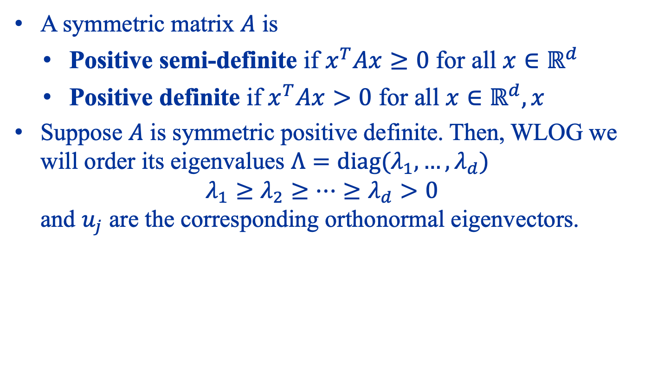
Review: Eigenvalues and Eigenvectors
A symmetric matrix $A$ is
Positive semi-definite if $x^{T}Ax≥0$ for all $x∈ℝ^{d}$
Positive definite if $x^{T}Ax>0$ for all $x∈ℝ^{d}, x$
Suppose $A$ is symmetric positive definite. Then, WLOG we will order its eigenvalues $Λ=diag(λ_{1},…, λ_{d})$ $λ_{1}≥λ_{2}≥…≥λ_{d}>0$ and $u_{j}$ are the corresponding orthonormal eigenvectors.

Slide 14
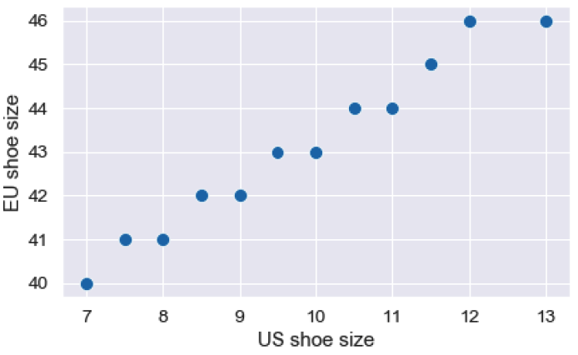
Motivating PCA: Shoe Sizes

Slide 15
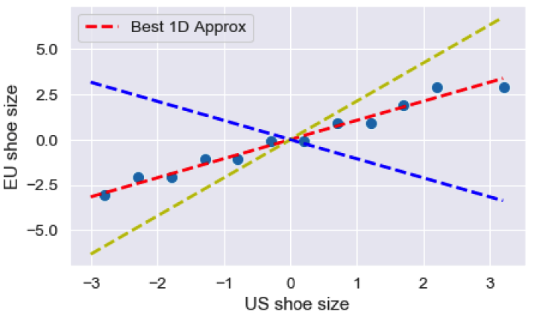
Capturing the Variation?
Although there are two dimensions to the data, there is really one effective dimension! How do we uncover this dimension?

Slide 16

A Dynamic Visualization

Slide 17
Two Formulations
Find the direction that captures the most variance
Find the direction that minimizes projection error

Slide 18
Derivation of PCA (Maximize Variance)

Slide 19
Derivation of PCA (Minimize Error)

Slide 20
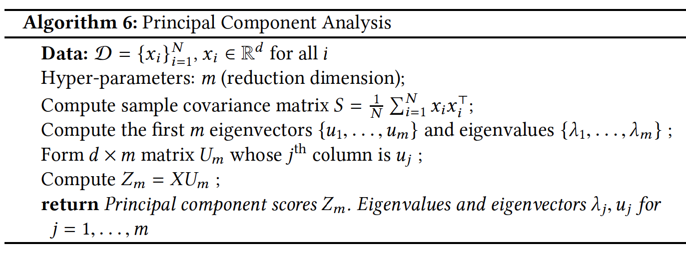
The PCA Algorithm

Slide 21

Simple Example
$$x_{1}=\left(1,1\right) \\ x_{2}=\left(−1,−1\right) \\ x_{3}=\left(ε,−ε\right) \\ x_{4}=\left(−ε,ε\right)$$

Slide 22
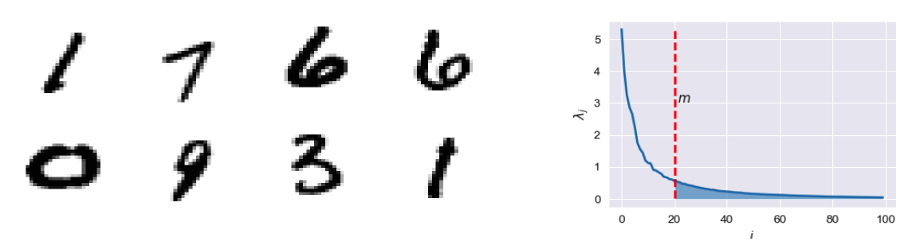
Choosing The Embedding Dimension

Slide 23
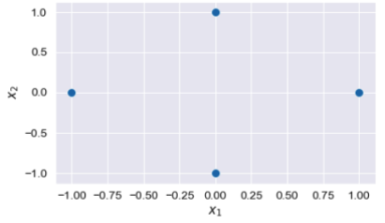
PCA in Feature Space (Example)

Slide 24
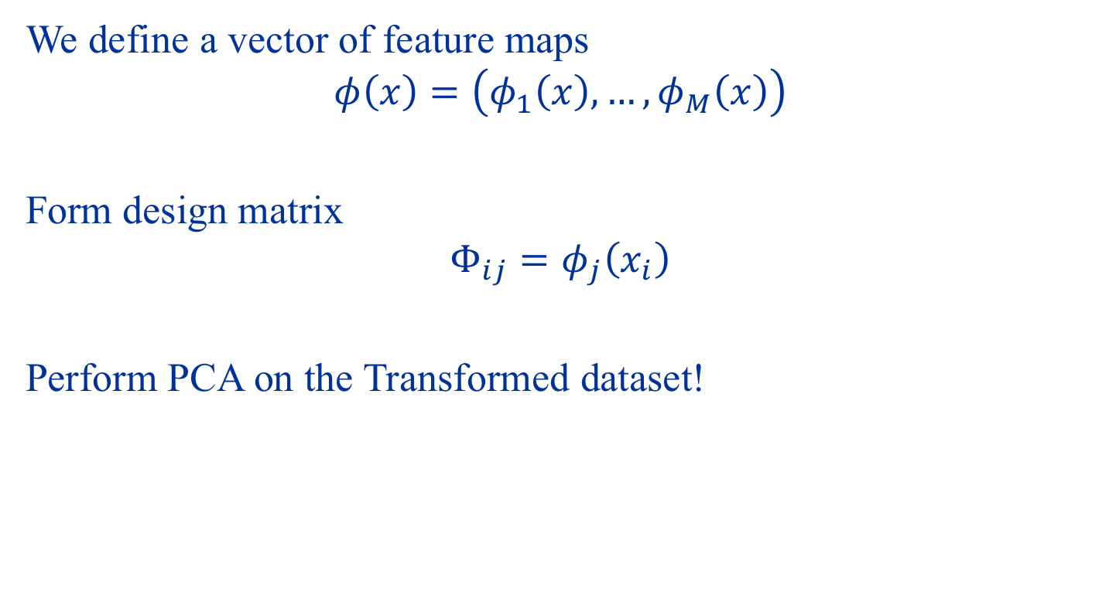
PCA in Feature Space
We define a vector of feature maps $$φ\left(x\right)=\left(φ_{1}\left(x\right),…,φ_{M}\left(x\right)\right)$$
Form design matrix $$Φ_{ij}=φ_{j}\left(x_{i}\right)$$
Perform PCA on the Transformed dataset!

Slide 25
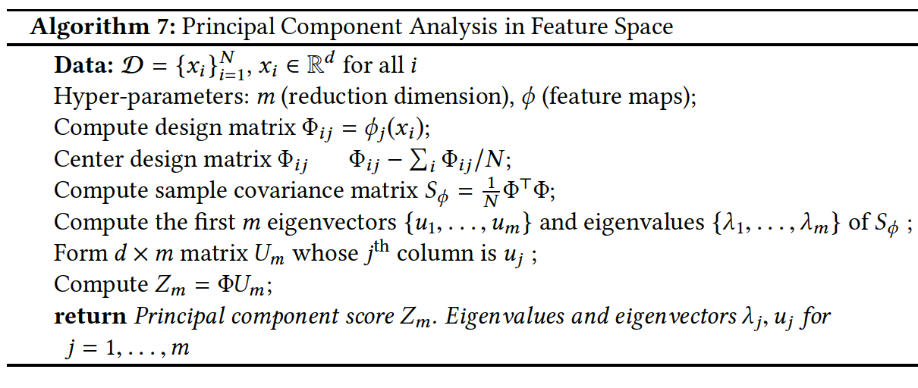
PCA in Feature Space

Slide 26
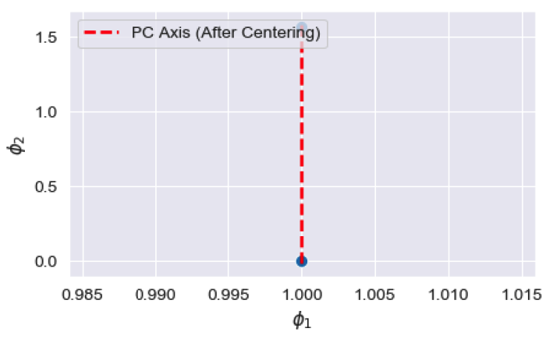

PCA in Feature Space (Example)
Define Feature Maps $$φ_{1}\left(x\right)=\left(x_{1}^{2}+x_{2}^{2}\right)$$
$$φ_{2}\left(x\right)=\tan^{−1}\left(\frac{x_{2}}{x_{1}}\right)$$

Slide 27
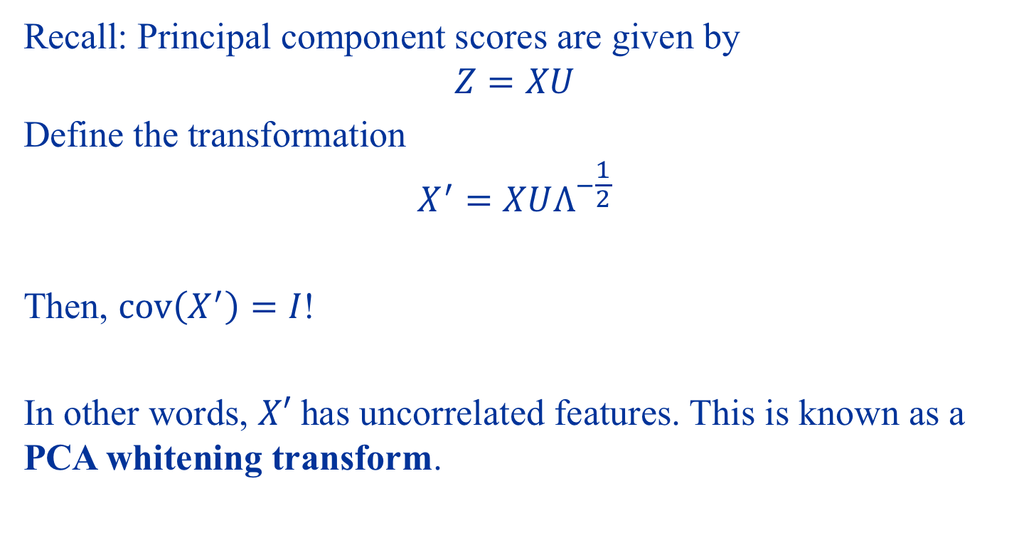
PCA as a Form of Whitening
Recall: Principal component scores are given by $$Z=XU$$
Define the transformation $$X^{′}=XUΛ^{−\frac{1}{2}}$$
Then, $cov\left(X^{′}\right)=I$!
In other words, $X′$ has uncorrelated features. This is known as a PCA whitening transform.

Slide 28
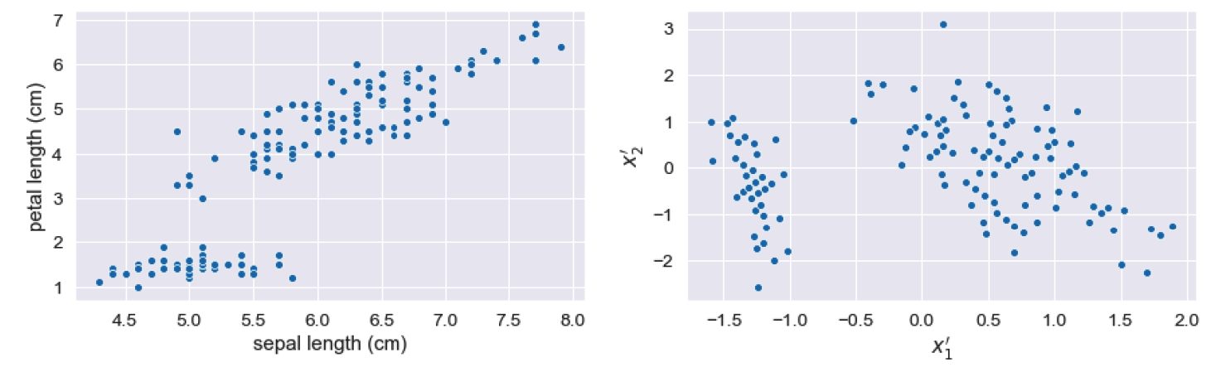
Example: Iris Dataset

Slide 29
Autoencoders

Slide 30
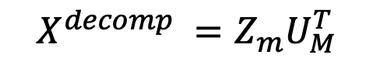
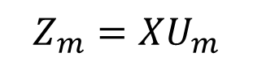
PCA as Compression Algorithm
$$Z_{m}=XU_{m}$$
$$X^{decomp} =Z_{m}U_{M}^{T}$$
Encoder
Decoder
Latent

Slide 31

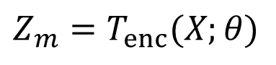
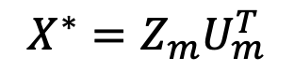
Autoencoders
In this sense, the autoencoder is a nonlinear counter-part of PCA based compression!
PCA:
$$Z_{m}=XU_{m}$$
$$X^{∗}=Z_{m}U_{m}^{T}$$
Encoder
Decoder
Latent
AE:
$$Z_{m}=T_{enc}(X;θ)$$
$$X^{∗}=T_{dec}\left(Z_{m};φ\right)$$

Slide 32
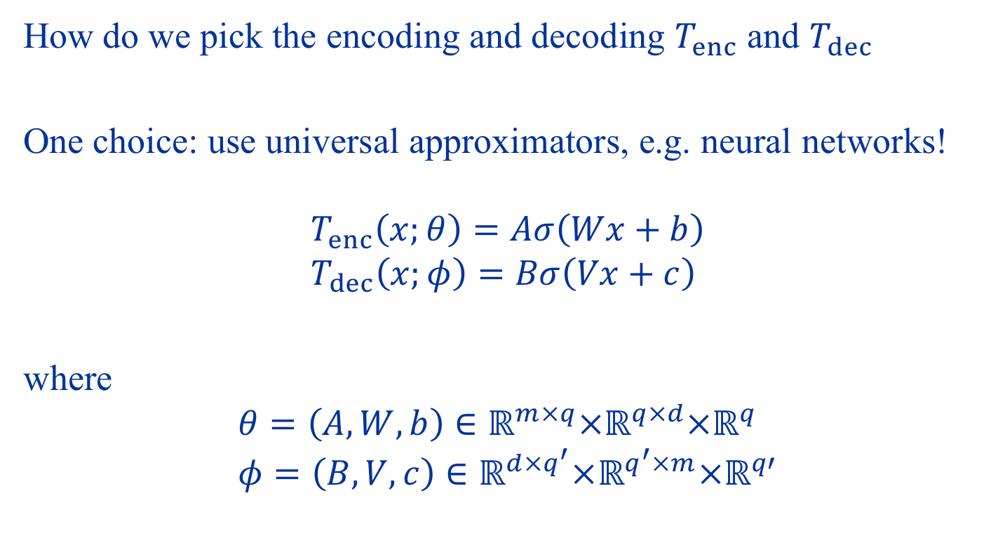
Neural Network Autoencoders
How do we pick the encoding and decoding $T_{enc}$ and $T_{dec}$
One choice: use universal approximators, e.g. neural networks! $$T_{enc}\left(x;θ\right)=Aσ\left(Wx+b\right) \\ T_{dec}\left(x;φ\right)=Bσ\left(Vx+c\right)$$
where
$$θ=\left(A,W,b\right)∈ℝ^{m×q}×ℝ^{q×d}×ℝ^{q} \\ φ=\left(B,V,c\right)∈ℝ^{d×q^{′}}×ℝ^{q^{′}×m}×ℝ^{q′}$$

Slide 33
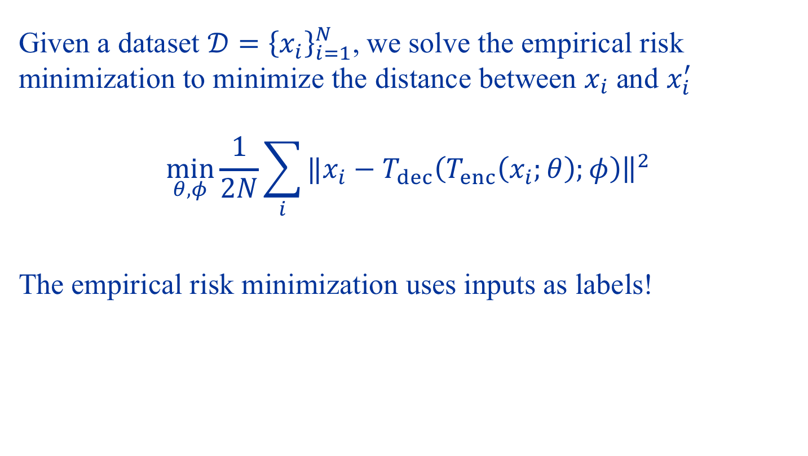
Neural Network Autoencoders
Given a dataset $𝒟={\left\{x_{i}\right\}}_{i=1}^{N}$, we solve the empirical risk minimization to minimize the distance between $x_{i}$ and $x_{i}^{′}$ $$\min_{θ,φ}{\frac{1}{2N}\sum_{i}{‖x_{i}{\left.​−T_{dec}\left(T_{enc}\left(x_{i};θ\right);φ\right)\right\|}^{2}}}$$
The empirical risk minimization uses inputs as labels!

Slide 34
Demo: PCA and Autoencoders

Slide 35
Summary
PCA fits an ellipsoid to data. Two interpretations:
Maximize variance
Minimize error
PCA is useful for:
Dimensionality reduction
Feature extraction / clustering
Data whitening
Viewed as a reconstruction algorithm, autoencoders is a nonlinear analogue of PCA

